Slide 1
Customer Success
Business Review
[ Template ]

Slide 2
BIG THANK YOU!
This template was created based on
Chad Horenfeldt’s QBR template which
he generously agreed to share with us.
Connect with him on Linkedin or follow
him on Twitter

Slide 3
Today’s Agenda
1. Partnerships Summary
2. Two-month Performance Metrics
3. Success Drivers
4. Product Updates
5. Next steps

Slide 4
Partnership Summary
Partnership Goal
To provide an exceptional user experience from tour to
move-in, while driving adoption of revenue-generating partnerships and amenities.
Launch History
[DATE] – [X] properties launched in [X] days
Live Properties
[X] properties are currently offering Updater!
Featured Providers
[Provider 1]
[Provider 2]
Feature-specific telecom providers
Noteworthy
This section would be used for misc. achievements from the first 2-months. For example, adding to LMS or sending an internal newsletter about Updater.

Slide 5
Let’s talk about
[Account Name]!

Slide 6
2-MONTH
PERFORMANCE METRICS

Slide 9
SUCCESS DRIVERS

Slide 12
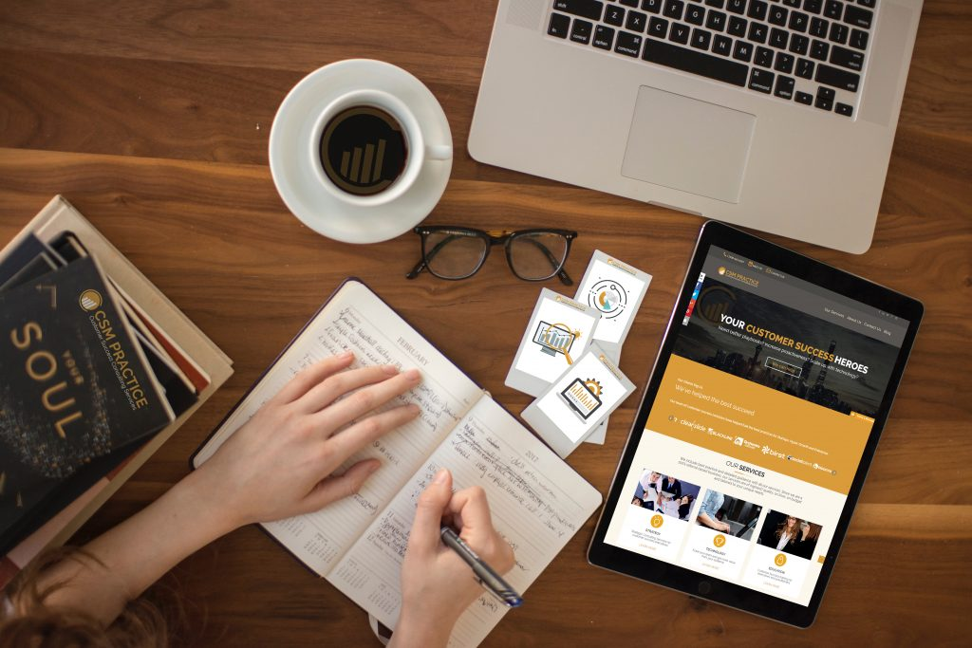
Timing is Everything
How does our solution work?
End User invitations are automatically triggered through your unique software platform.
Required
Process Milestones
First Name
Last Name
Email Address
First Login Date
Invitation Sent
First Login
Walk Through
First Value delivered
Advance Training
Invite Timing
Sent 35 days prior to first login time or the next business day from when triggers are met

Slide 15
PRODUCT UPDATES

Slide 16
Product Updates
Value Statement #1
This is where we would put the latest updates related to key differentiating proposition.
Update 1
Update 2
[Link to product blog feature or other resource]
Value Statement #2
This is where we would put the latest updates on our second value proposition.
Update 1
Update 2
[Link to product blog feature or other resource]
Value Statement #3
This is where we would put the latest updates on on our second value proposition.
Update 1
Update 2
[Link to product blog feature or other resource]

Slide 17
Next Steps
DO THIS
Please let us know of any portfolio or contact changes.
DO THAT
Add a custom product features online courses to your LMS – we’ll send over the materials.
DO SOMETHING ELSE
Updater to email low-performing teams with helpful tips.

Slide 18
Client Health Check Overview
What is a “Health Check”?
This is a technical review of the client’s instance, in terms of configuration of the
platform, and how they understand the features. We can then provide suggestions
on best practices, and set time for any questions or follow up actions, if necessary.
How does it differ from an Account Review or QBR?
Account Review / QBR goes beyond the product. This gives
a holistic understanding of what business outcomes the client
is trying to achieve, why they chose Kustomer, any turnover,
their business health, and review of what has been
accomplished since the last review.
Can the Health Check and Account Review be used in conjunction?
Absolutely! This will give us better understanding of the overall
client health, minimize churn rate, and provide a
better customer experience.

Slide 19
CSM Practice is here to help.
Not sure about your current QBR process? Do you want your team to nail the next business with clients? How can you leverage business reviews with clients to deepen the relationship of your CSMs with your customers?
CSM Practice can help you navigate the intricacy of business reviews. Please contact us at CSM Practice to increase your profitably and generate new business outcomes for your customers
Does your Customer Success team
need support?
LET’S TALK

